Slide 1

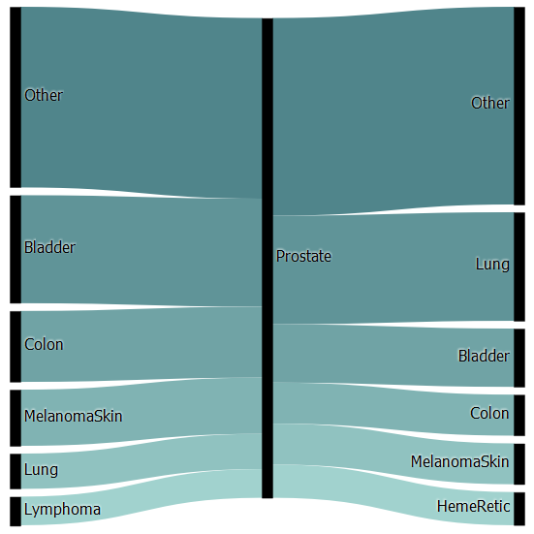
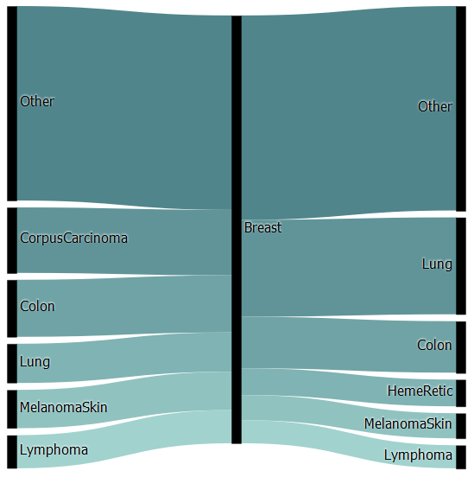
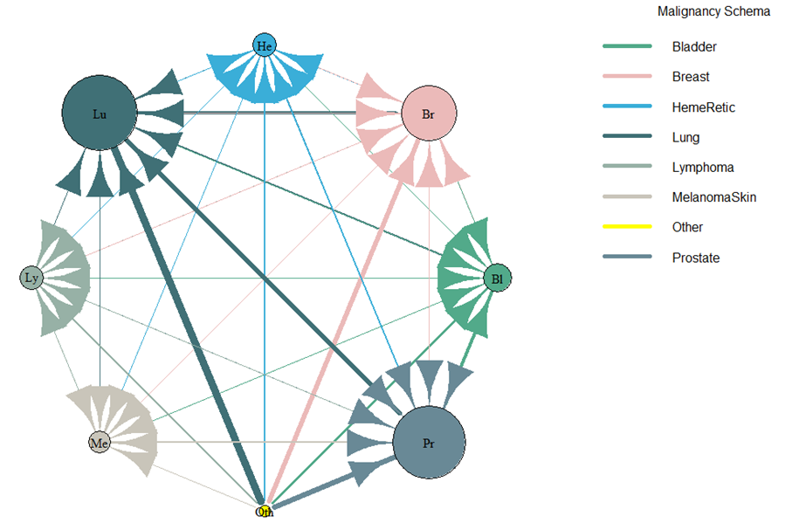
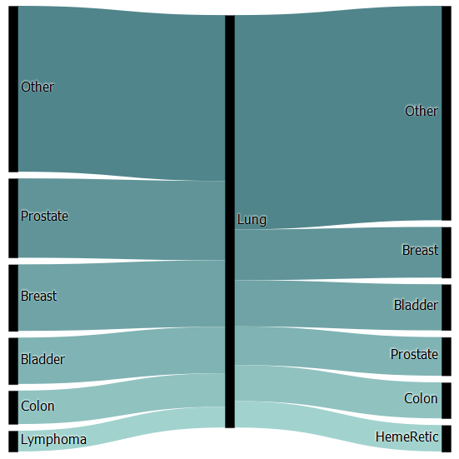
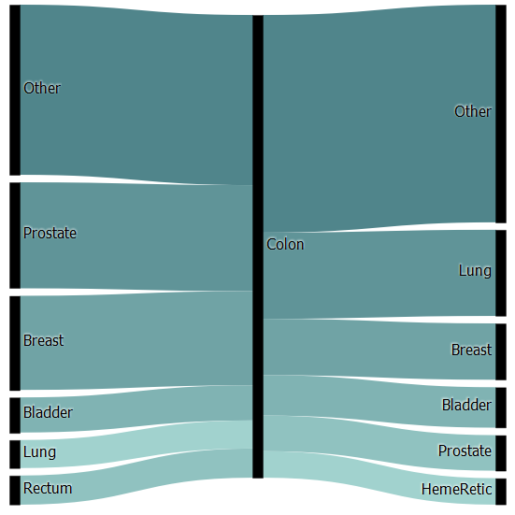
Multiple Primary Cancers: Associations & Network Link Analysis
By Zachary Zindaᴵ, Arshiya Mariamᴵ, & Elena Manilich, PhDᴵ
ᴵJohn Carroll University, Department of Mathematics & Computer Science
Funding for this study provided by the Richard M. Weaver ’78 and Jeanne M. Colleran ’76 Summer Undergraduate Research Fellowship.
Introduction
Association Rule Learning
Network Link Analysis
According to the most recent estimates, multiple primary malignant neoplasms (MPMNs) comprise up to 17% of cancer diagnoses in the recorded literature.¹ Additionally, the American Cancer Society’s latest report posits that 1.7 million new cancer cases are expected to be diagnosed in 2018, meaning that up to 289,000 new MPMNs could be diagnosed in 2018 alone.²
MPMNs are further subdivided into two categories: synchronous and metachronous. The Surveillance, Epidemiology, and End Results (SEER) Program defines a synchronous primary as occurring within 60 days, or roughly two months, after an initial primary, whereas metachronous primaries are those manifesting after this two-month window.¹
Even with a more generous six-month window, however, metachronous multiple primaries outnumber synchronous primaries 2.7 to 1.³ Thus, roughly 211,000 metachronous MPMNs are expected to be diagnosed in 2018.
The purpose of this study is to assess the likelihood that the type of initial malignancy is a significant factor in the types of second and/or higher-ordered malignancies. A common refrain throughout the current medical literature is that second and higher-ordered primaries can be therapy induced, syndrome related, or resulting from shared etiological factors, such as a genetic disposition or an environmental factor.^{4,5} This study suggests that the type of initial malignancy should also be taken into consideration when assessing the probability of future malignancies.
Prostate Cancer
Figure 1.1: Top Most Frequent Malignancies Leading to and from a Secondary Prostate Malignancy.
Breast Cancer
Figure 1.2: Top Most Frequent Malignancies Leading to and from a Secondary Breast Malignancy
Figure 2: Network Diagram of the Top Cumulatively-Ranked Cancer Types.
The overall ranking of relative importance is represented by the radius of the malignancy node; and the width of each edge represents the total number of patients exhibiting that relationship.
Prostate cancer appeared most frequently in our dataset, with 187,442 patients diagnosed at least once. Bladder cancer was the leading antecedent to prostate cancer with a 21.5% frequency rate. Lung cancer was the leading consequent at a 21.04% frequency rate.
Breast cancer appeared second-most frequent in our dataset, with 169,647 patients diagnosed at least once. Uterine cancer was the leading antecedent to breast cancer with a 16.24% frequency rate. Lung cancer was the leading consequent at a 18.70% frequency rate.
Methodology
Lung Cancer
Figure 1.3: Top Most Frequent Malignancies Leading to and from a Secondary Lung Malignancy
Colon Cancer
Figure 1.4: Top Most Frequent Malignancies Leading to and from a Secondary Colon Malignancy
Relative importance is an indication of the number of cancers that lead to, or eventually result in, the specific cancer of interest. The relative importance of each cancer is determined 1) by the number of malignancies leading to that cancer type, and 2) by the relative importance of each of those incoming malignancies. Lung cancer had the highest relative importance in our dataset, with 102 distinct cancers leading to a total of over108,000 second or higher-ordered lung malignancies.
Data Retrieval
Data was retrieved from the National Cancer Institute’s Surveillance, Epidemiology, and End Results (SEER) Program. The SEER Research Data encompasses patient records from 1973-2015 and is one of the most comprehensive databases of cancer records to-date. At the onset of our analysis, the SEER Research Data had 10,050,814 records. Records were filtered as malignant according to the SEER Behavior Record for Analysis. Records were included so long as the recorded tumors were classified as malignant under the ICD-O-3 coding scheme. Records were then filtered according to the total number of tumors per patient. 89.53% of patients had only 1 recorded malignancy, 10.44% of patients had 2-4, and the last 0.03% had 5+. Only patients with 2-4 recorded malignancies were included in our analysis. Finally, each non-index tumor was classified as either synchronous or metachronous.
We adhered to the SEER Project guidelines for delineating synchronous and metachronous malignancies, using a 2-month window to classify secondary and higher-order tumors. Records were included only if all non-index tumors were confirmed to be metachronous. Thus, if a patient had 4 recorded malignancies, but only the second was metachronous, the record was not included in our final analysis.
Analysis
After the initial preprocessing, we approached the data from two angles: network link analysis and association rule learning. First, we employed Google’s PageRank Analysis, a network link analysis method to differentiate the relative importance of secondary and higher-order malignancies. This technique has been used for distinguishing genes with greater prognostic value⁶ as well as protein interactions.⁷ In this study, the prognosis of interest was the development of other tumors in each cancer sample population as well as the most common cancerous occurrences across all the samples. Next, we employed the Parallel FP-Growth algorithm introduced by Li et al. in 2008⁸ to identify common relationships between index and higher-order tumors. FP-Growth has also been used for analyzing liver cancer, successfully identifying cancer-specific patient characteristics with significant levels of confidence.⁹ Data analysis and computations were done on Google Cloud servers using Apache PySpark and the R statistical programming language.
Bibliography
¹Vogt A, Schmid S, Heinimann K, et al. Multiple primary tumours: challenges and approaches, a review. ESMO Open. 2017;2:e000172. doi:10.1136/esmoopen-2017-00017.
²American Cancer Society. Cancer Facts & Figures 2018. Atlanta: American Cancer Society; 2018.
³Testori A, Cioffi U, De Simone M, et al. Multiple primary synchronous malignant tumors. BMC Research Notes. 2015;8:730. doi:10.1186/s13104-015-1724-5.
⁴Sakellakis M, Peroukides S, Iconomou G, Boumpoucheropoulos S, Kalofonos H. Multiple primary malignancies: a report of two cases. Chinese Journal of Cancer Research. 2014;26(2):215-218. doi:10.3978/j.issn.1000-9604.2014.02.15.
⁵Takalkar U, Asegaonkar BN, Kodlikeri P, Asegaonkar S, Sharma B, Advani SH. An elderly woman with triple primary metachronous malignancy: A case report and review of literature. International Journal of Surgery Case Reports. 2013;4(7):593-596. doi:10.1016/j.ijscr.2013.03.032.
⁶Winter C, Kristiansen G, Kersting S, Roy J, Aust D, et al. (2012). Google Goes Cancer: Improving Outcome Prediction for Cancer Patients by Network-Based Ranking of Marker Genes. PLOS Computational Biology 8(5): e1002511. https://doi.org/10.1371/journal.pcbi.1002511
⁷Gábor Iván, Vince Grolmusz; When the Web meets the cell: using personalized PageRank for analyzing protein interaction networks, Bioinformatics, Volume 27, Issue 3, 1 February 2011, Pages 405–407, https://doi.org/10.1093/bioinformatics/btq680
⁸Haoyuan Li, Yi Wang, Dong Zhang, Ming Zhang, and Edward Y. Chang. (2008). Pfp: parallel fp-growth for query recommendation. In Proceedings of the 2008 ACM conference on Recommender systems (RecSys '08). ACM, New York, NY, USA, 107-114. DOI=http://dx.doi.org/10.1145/1454008.1454027
⁹Kuo, Mu-Hsing & Hung, Chang-Mao & Barnett, Jeff & Pinheiro, Fabiola. (2012). Assessing the feasibility of data mining techniques for early liver cancer detection. Studies in health technology and informatics. 180. 584-8. 10.3233/978-1-61499-101-4-584.
Lung cancer appeared third-most frequent in our dataset, with 150,205 patients diagnosed at least once. Prostate cancer was the leading antecedent to lung cancer with a 21.54% frequency rate. Breast cancer was the leading consequent at a 12.01% frequency rate.
Colon cancer appeared fourth-most frequent in our dataset, with 104,664 patients diagnosed at least once. Prostate cancer was the leading antecedent to colon cancer with a 24.31% frequency rate. Lung cancer was the leading consequent at a 18.15% frequency rate.
Biblography
¹Vogt A, Schmid S, Heinimann K, et al. Multiple primary tumours: challenges and approaches, a review. ESMO Open. 2017;2:e000172. doi:10.1136/esmoopen-2017-00017.
²American Cancer Society. Cancer Facts & Figures 2018. Atlanta: American Cancer Society; 2018.
³Testori A, Cioffi U, De Simone M, et al. Multiple primary synchronous malignant tumors. BMC Research Notes. 2015;8:730. doi:10.1186/s13104-015-1724-5.
⁴Sakellakis M, Peroukides S, Iconomou G, Boumpoucheropoulos S, Kalofonos H. Multiple primary malignancies: a report of two cases. Chinese Journal of Cancer Research. 2014;26(2):215-218. doi:10.3978/j.issn.1000-9604.2014.02.15.
⁵Takalkar U, Asegaonkar BN, Kodlikeri P, Asegaonkar S, Sharma B, Advani SH. An elderly woman with triple primary metachronous malignancy: A case report and review of literature. International Journal of Surgery Case Reports. 2013;4(7):593-596. doi:10.1016/j.ijscr.2013.03.032.
⁶Winter C, Kristiansen G, Kersting S, Roy J, Aust D, et al. (2012). Google Goes Cancer: Improving Outcome Prediction for Cancer Patients by Network-Based Ranking of Marker Genes. PLOS Computational Biology 8(5): e1002511. https://doi.org/10.1371/journal.pcbi.1002511
⁷Gábor Iván, Vince Grolmusz; When the Web meets the cell: using personalized PageRank for analyzing protein interaction networks, Bioinformatics, Volume 27, Issue 3, 1 February 2011, Pages 405–407, https://doi.org/10.1093/bioinformatics/btq680
⁸Haoyuan Li, Yi Wang, Dong Zhang, Ming Zhang, and Edward Y. Chang. (2008). Pfp: parallel fp-growth for query recommendation. In Proceedings of the 2008 ACM conference on Recommender systems (RecSys '08). ACM, New York, NY, USA, 107-114. DOI=http://dx.doi.org/10.1145/1454008.1454027
⁹Kuo, Mu-Hsing & Hung, Chang-Mao & Barnett, Jeff & Pinheiro, Fabiola. (2012). Assessing the feasibility of data mining techniques for early liver cancer detection. Studies in health technology and informatics. 180. 584-8. 10.3233/978-1-61499-101-4-584.

